Slide 1


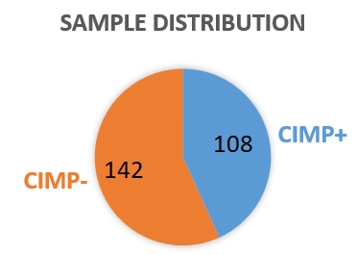
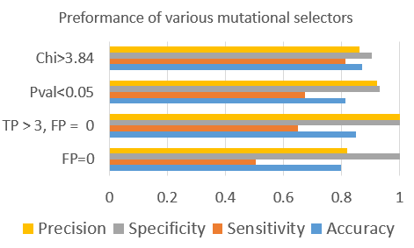
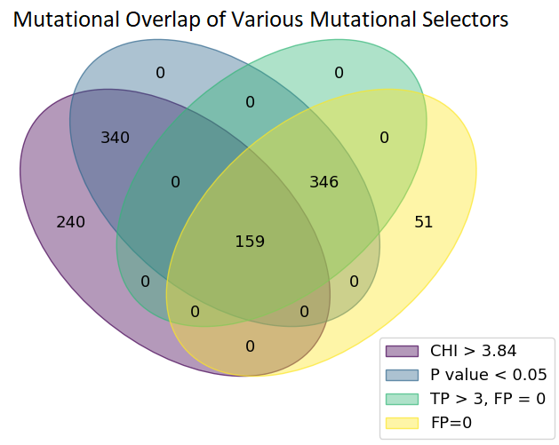
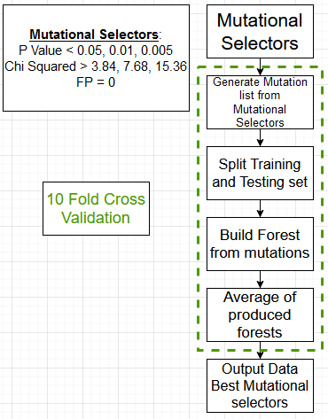
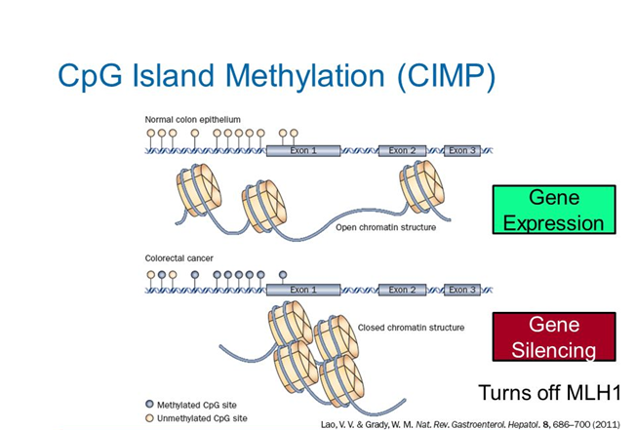
Performance of somatic mutations in classification of endometrial carcinomas with CpG island methylator phenotype
Jonathan Feige ^{1,2}, Dr. Lonnie Welch ¹, Dr. Laura Elnitski ²
1 - School of Electrical Engineering and Computer Science, Ohio University
2 - Translational and Functional Genomics Branch, National Human Genome Research Institute, National Institutes of Health
Abstract
Materials
Results
Conclusion
Endometrial carcinoma is a type of uterine cancer that begins in the endometrium lining within the uterus. A subset of these tumors show genome hypermethylation, resulting in down-regulation of tumor suppressor genes. This is commonly referred to as CpG island methylator phenotype (CIMP).
Our working hypothesis is that DNA mutations in endometrial tumors can be used to predict CIMP. This capability will be useful when DNA methylation data is not available for analysis. Being able to quickly and accurately classify CIMP patients will lead to better diagnostics and therapies.
The data is from The Cancer Genome Atlas. The samples retrieved contains both methylation data and mutational data.
The data consists
of 250 unique samples:
108 CIMP+,142 CIMP-.
There are 8085 total
mutations. Of the 8085
mutations, 739 demonstrated
a strong correlation to either the
CIMP+ or the CIMP- grouping.
Using only these mutations we can classify samples with an accuracy between 100 and 70 precent. On average, we can classify samples with 87% accuracy, using 159 mutations.
We found that it is possible to classify samples as CIMP with high accuracy using mutational data.
This breakthrough in technology could give us the ability to classify unknown samples, which could lead to improved diagnostics and therapeutics.
Methodology
Our goal is to correctly classify tumors as CIMP+ or CIMP- by building a random forest classifier.
We used the following approaches for mutation selection
Fishers exact p value threshold
Chi Squared significance test
The group of mutations that only exist in CIMP+ (i.e., False Positive (FP) = 0)
Next Steps
Introduction
Validate the model with an existing dataset or newly generated data dataset, which must include mutations and methylation data. This can be in the form of an independent dataset or a new experiment.
Explore the relationships between mutations. This can take form in many different statistical methods, to identify strong correlations in the data.
Interpret the findings from a biological perspective. This would take form in various biological analyses to determine a linkage between biological pathways, cancer, and CIMP.
Endometrial carcinoma is a type of uterine cancer. Approximately 66,000 cases per year with a fatality rate of ~20% (13,000). We previously found that cancers can have different DNA methylation patterns
Some cancers can have extensive gain of DNA methylation resulting in CIMP. There are three subtypes of CIMP: CIMP positive, CIMP negative, and CIMP intermediate.
Tumor suppressor and DNA repair genes are frequently silenced in CIMP+ cases.
Acknowledgements
I would like to thank Catherine Baugher (NHGRI) and Derek Petrosian (NHGRI) for their contribution to the refinement of the project.

